Slide 1
Whole genomes
Gibran Hemani
g.hemani@bristol.ac.uk

Slide 2
Outline
Genetic relatedness
Heritability
The GCTA approach
Latest developments

Slide 3
Combining two concepts
GWAS using SNP chips on unrelated individuals
Heritability
Question: Is 500,000 SNPs on a SNP chip enough to capture all the causal variants that underlie heritability?

Slide 4
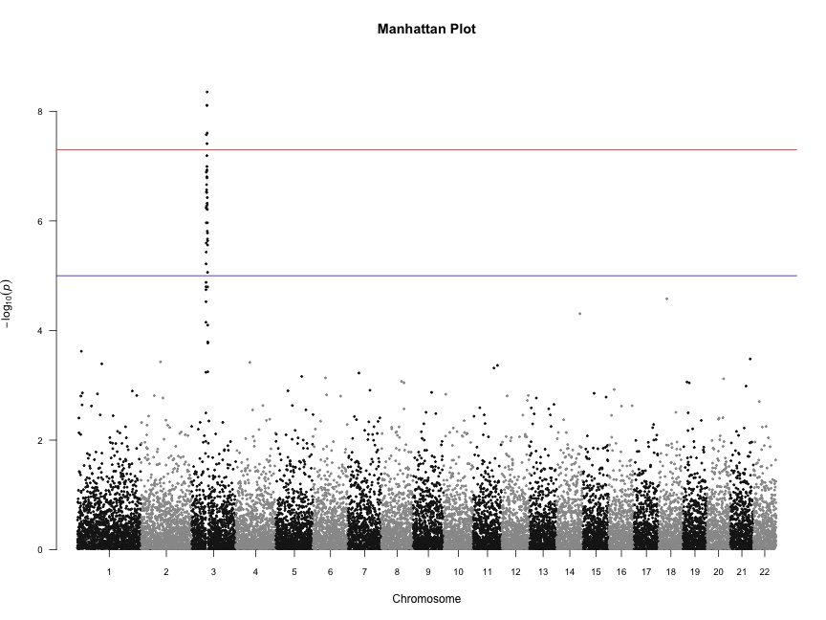
Above and below the threshold
Notes:
This talk is going to eventually be about trying to understand what role, if any those SNPs below the significance threshold play

Slide 5
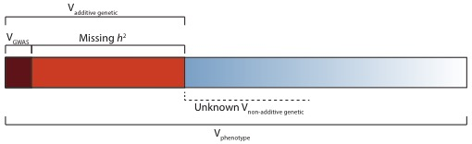
Missing heritability

Slide 6
Where is GWAS going?
How much variance does our significant SNP explain?
V_{A}/V_{P} = 2a²p(1-p)/V_{P}
Usually very small
Much less than the total heritability predicted to exist from pedigree and twin studies
AKA the missing heritability problem

Slide 7
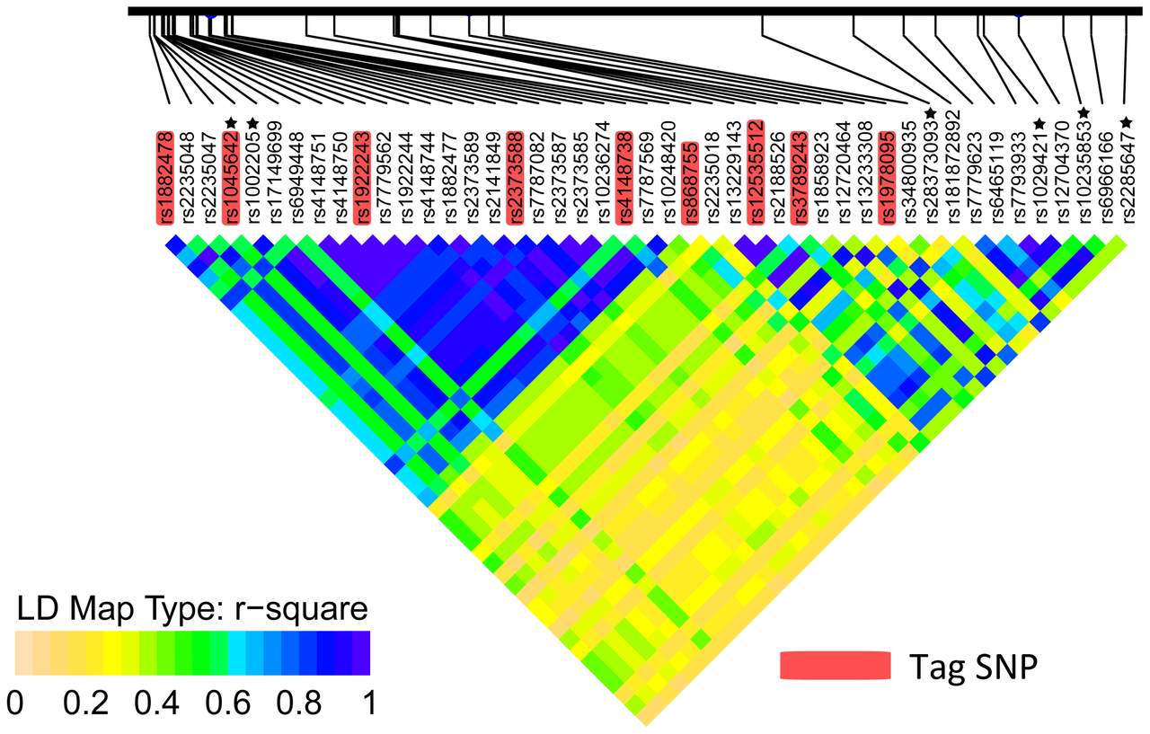
Where is GWAS going?
SNP chips use common tagging SNPs
Question: How much of total heritability have we managed to capture using this technology?
Around 12 million common variants
SNP chips usually have fewer than 1 million
Estimated to capture at least 80% of genetic variation
Countless millions of rare variants
SNP chips capture very tiny proportion of rare variation in unrelated individuals

Slide 8
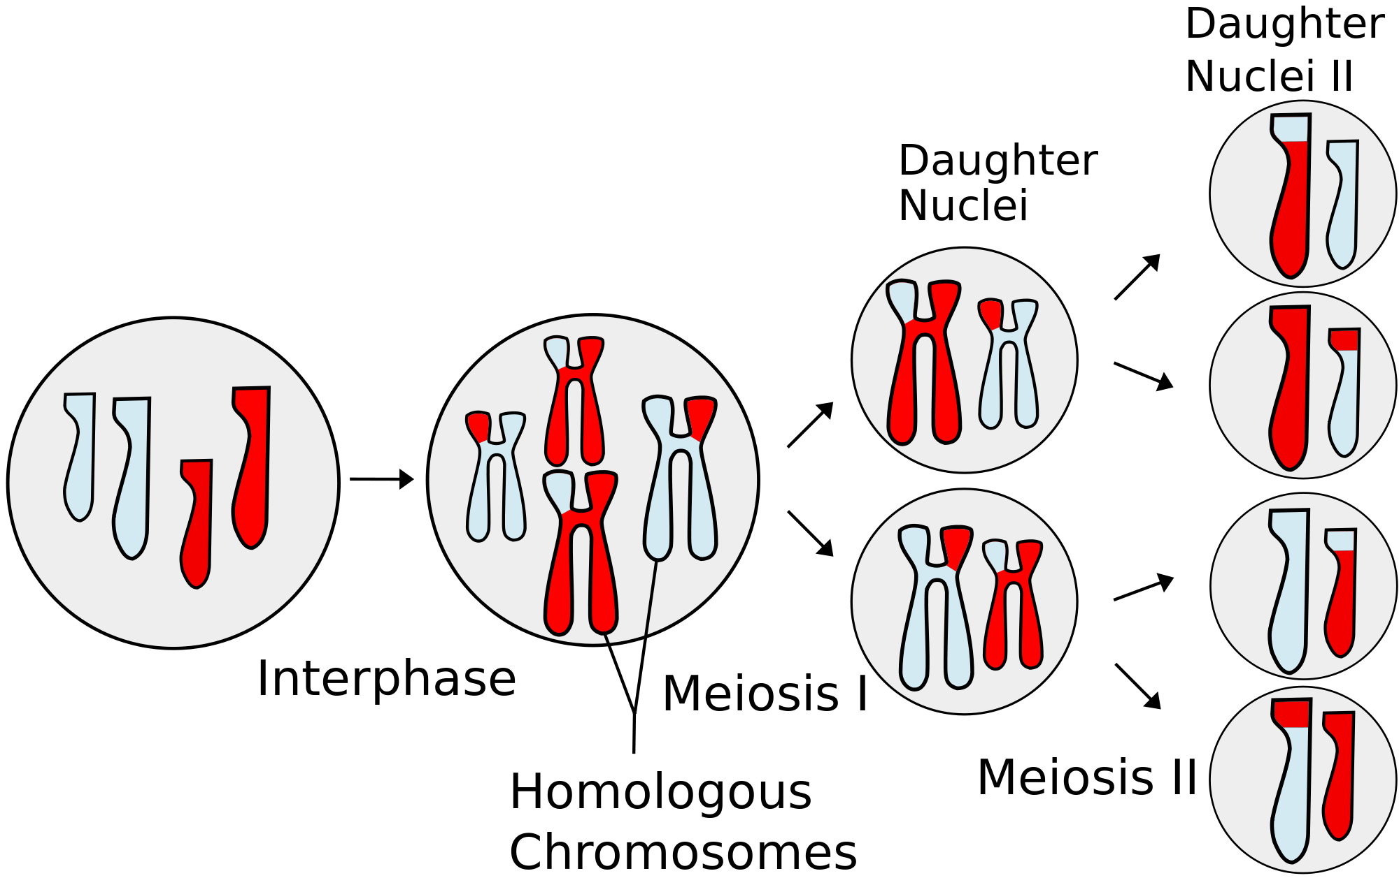
Family relatedness
Family tree: degrees of relatedness
Meiosis: random shuffling
Notes:
Two points:
The family tree depicts the degrees of relatedness between any two individuals depicted in the tree
Meiosis makes this picture less clear: the relatedness shown in the family tree is EXPECTED genetic relatedness, meiosis is a process whereby the two copies of a chromosome in the parent are mixed up to create a new single copy that is a mixture of the two original copies. Whenever this process happens you make a new random shuffling

Slide 9
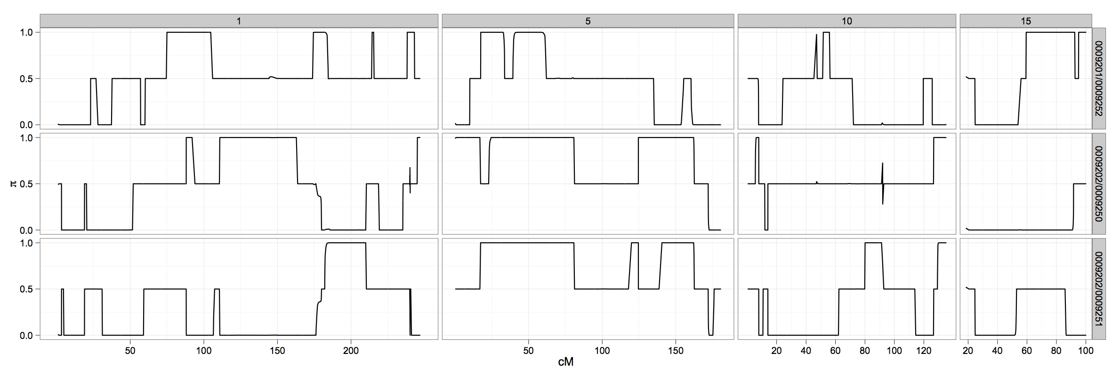
Siblings: Realised genetic sharing
Notes:
Depict the genetic sharing using volta plots – as you go along the chromosome you see that the two siblings either share both copies IBD, 1 copy IBD, or have each inherited different copies

Slide 10
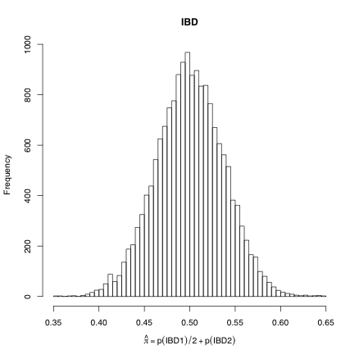
Siblings: realised genetic sharing
Notes:
This is the distribution of the total amount of genetic sharing between two siblings. Notice: the mean=0.5 as we expect but there is a distribution here.

Slide 11
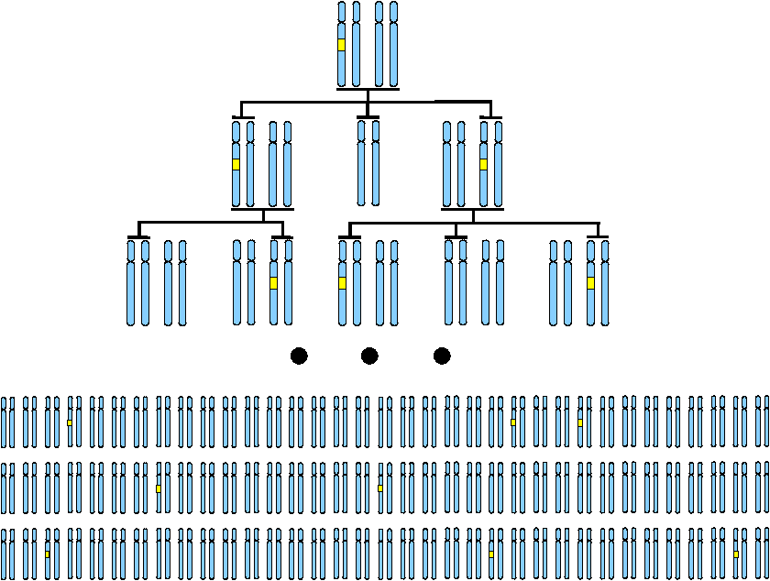
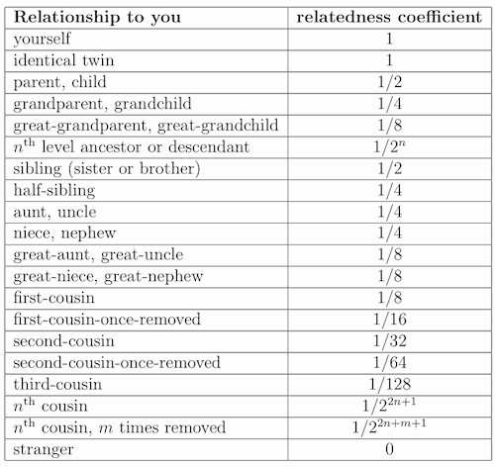
Identity by descent
Segment of DNA shared by two or more people that has been inherited from a recent common ancestor without any intervening recombination
Relatedness (or kinship) coefficients
Notes:
Segments of DNA are passed on and we can define total genomic sharing as the proportion of total DNA that two individuals share that is identical by descent.
The expected values are shown in the table.
Notice – it’s kind of arbitrary where we decide to stop and end up just giving a value of 0

Slide 12
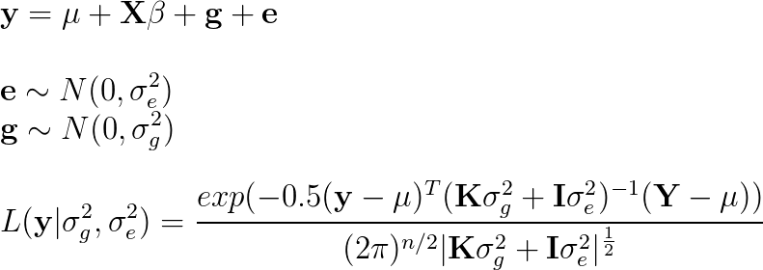
Mixed model approach
Partition variance into covariates,
genetic effects and residuals
Use REML to maximise likelihood for estimation of σ_{g}² and σ_{e}² parameters
Notes:
Mention common environmental variance

Slide 13
Mixed model approach
1 0.5 0.13 0.01 0.09 0.01
0.5 1 0.13 0.02 0.07 0.04
0.13 0.13 1 0.03 0.01 0.05
0.01 0.02 0.03 1 0.25 1
0.09 0.07 0.01 0.25 1 0.38
0.01 0.04 0.05 1 0.38 1
1
1
1
-1
-1
-1
1 1 1 -1 -1 -1
1 1 1 -1 -1 -1
1 1 1 -1 -1 -1
-1 -1 -1 1 1 1
-1 -1 -1 1 1 1
-1 -1 -1 1 1 1
σ_{g}²
σ_{e}²
Phenotype Y
Phen covariance YY^{T}
1 0 0 0 0 0
0 1 0 0 0 0
0 0 1 0 0 0
0 0 0 1 0 0
0 0 0 0 1 0
0 0 0 0 0 1
Use REML to divide phenotypic variance into:
σ_{g}² = Genetic covariance matrix
σ_{e}² = Residual error
Then we can estimate h² = σ_{g}² / (σ_{g}² + σ_{e}²)
Notes:
Trying to explain as much phenotypic covariance as possible using the genetic covariance

Slide 14
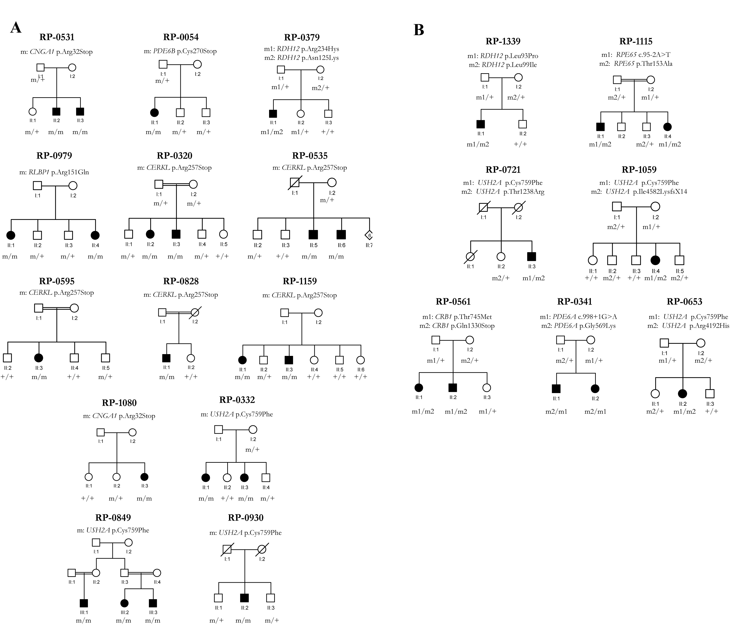
Problem: Pedigrees are always incomplete
If pedigrees are incomplete then the relatedness coefficients that we are using are wrong
Notes:
If it turns out that a founder from family 1 is actually a cousin to a founder from family 2 then there are a lot of incorrect 0s!

Slide 15
Estimating the realised genomic similarity using SNPs: Identity by state (IBS)
Objective: For each pair of individuals see how many alleles they have in common as a proportion of all alleles – this is our measure of genetic similarity
Step 1: Take all your SNPs and normalise them so that they have mean 0 and variance 1
Step 2: For each pair of individuals increase their score when they have the same genotype at a SNP, decrease it when they have a different genotype

Slide 16
Estimating the realised genomic similarity using SNPs
Raw genetic data, S matrix
Scale each SNP to have mean 0, variance 1, Z matrix
ID | SNP1 | SNP2 | SNP3
1 | 0 | 2 | 0
2 | 1 | 1 | 2
3 | 0 | 0 | 0
4 | 0 | 2 | 1
5 | 1 | 2 | 2
6 | 0 | 1 | 1
7 | 2 | 0 | 0
ID | SNP1 | SNP2 | SNP3
1 | -0.7 | 2.1 | -1.0
2 | 0.5 | -0.5 | 1.3
3 | -0.7 | -0.4 | -1.0
4 | -0.7 | 2.1 | 0.2
5 | 0.5 | 2.1 | 1.3
6 | -0.7 | -0.5 | 0.2
7 | 1.8 | -0.4 | -1.0
Notes:
Step 1: Why normalise?
Imagine a SNP with low MAF – lots of people with 0 genotype, more likely to have high sharing by chance: low variance = low contribution to genomic sharing
Compare to a SNP with intermediate MAF – more likely to be lower sharing because more possible combinations: high variance = high contribution to genomic sharing
By normalising we are making equal contribution for all SNPs

Slide 17
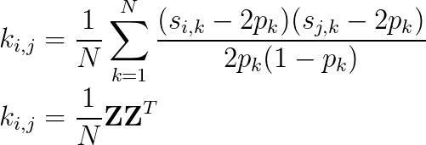
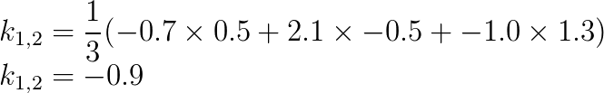
Estimating the realised genomic similarity using SNPs
Z matrix:
Calculating genetic relationship matrix
(or kinship matrix):
ID | SNP1 | SNP2 | SNP3
1 | -0.7 | 2.1 | -1.0
2 | 0.5 | -0.5 | 1.3
3 | -0.7 | -0.4 | -1.0
4 | -0.7 | 2.1 | 0.2
5 | 0.5 | 2.1 | 1.3
6 | -0.7 | -0.5 | 0.2
7 | 1.8 | -0.4 | -1.0
Example:
Notes:
This is a big operation. It is making an n x n matrix, and for each cell in that matrix they had to do N sums

Slide 18
Use GCTA to calculate genetic IBS

Slide 19
Mixed model
1 0.5 0.25 0.00 0.00 0.13
0.5 1 0.00 0.00 0.00 0.00
0.25 0.00 1 0.25 0.00 0.13
0.00 0.00 0.25 1 0.25 1
0.00 0.00 0.00 0.25 1 0.00
0.25 0.00 0.13 1 0.00 1
1
1
1
-1
-1
-1
1 1 1 -1 -1 -1
1 1 1 -1 -1 -1
1 1 1 -1 -1 -1
-1 -1 -1 1 1 1
-1 -1 -1 1 1 1
-1 -1 -1 1 1 1
σ_{g}²
σ_{e}²
Phenotype Y
Phen covariance YY^{T}
1 0 0 0 0 0
0 1 0 0 0 0
0 0 1 0 0 0
0 0 0 1 0 0
0 0 0 0 1 0
0 0 0 0 0 1
We simply use the realised genetic kinship matrix to estimate the σ_{g}² paramater now

Slide 20
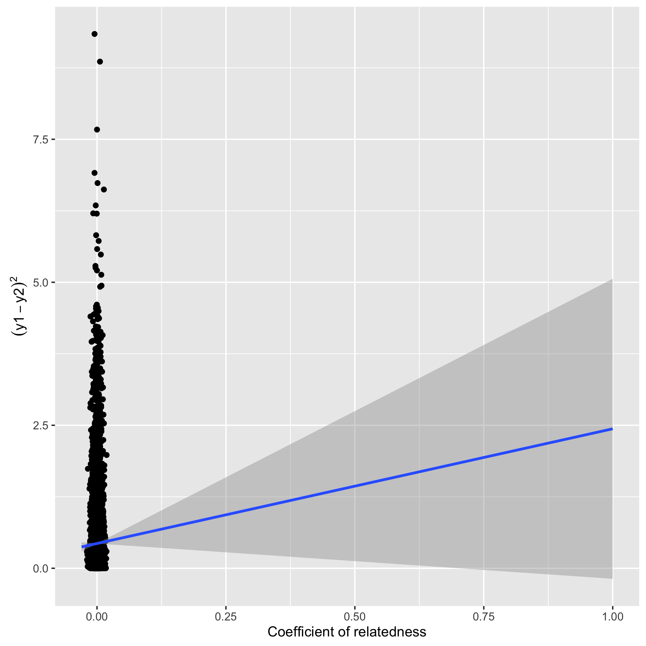
Precision of heritability estimates
Using family data
Using unrelateds
Notes:
Higher precision with closer relationships
Higher precision when using actual amount of genetic sharing compared to expected amount
Higher precision when pedigree is more complete

Slide 21
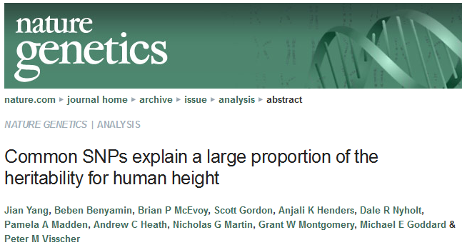
GCTA GREML
Why go in this direction?
Using unrelateds leads to lower precision!
There is a lot of data on unrelated individuals
Unrelateds don’t have problems of common environment confounding
It’s actually trying to answer quite a different question
Applied SNP-based heritability analysis using only unrelated individuals:
Realised genetic relatedness is required (otherwise all k=0!)

Slide 22
When individuals are related…
Slide courtesy of Doug Speed
Causal SNP A
Causal SNP B
Individuals 1 and 2
Individuals 1 and 3
Individuals 1 and 4
Individuals 2 and 3
Individuals 2 and 4
Individuals 3 and 4
Typed SNP 1
Typed SNP 2
Notes:
Long IBD segments, only need a few SNPs to capture all the variation

Slide 23
When individuals are unrelated…
Slide courtesy of Doug Speed
Causal SNP A
Causal SNP B
Individuals 1 and 2
Individuals 1 and 3
Individuals 1 and 4
Individuals 2 and 3
Individuals 2 and 4
Individuals 3 and 4
Typed SNP 1
Typed SNP 2
SNP heritability = proportion of phenotypic variance explained by all measured SNPs
Notes:
Smaller segments of IBD
If the causal variant is far from the closest tag SNP then its variance will not be captured

Slide 24
Length of IBD segments reduce when people are less related
Speed & Balding 2015
Notes:
Also higher chance of new or recent mutations having arisen on old haplotypes when comparing individuals who are more unrelated

Slide 25
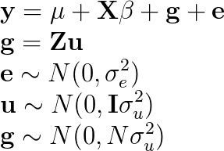
Interpreting SNP heritability
Y = α
+ β₁ X₁ + β₂ X₂ + β₃ X₃ + β₄ X₄ + β₅ X₅ + β₆ X₆ + β₇ X₇ + β₈ X₈
+ β₉ X₉ + β₁₀X₁₀ + β₁₁X₁₁ + β₁₂X₁₂ + β₁₃X₁₃ + β₁₄X₁₄ + β₁₅X₁₅ + β₁₆X₁₆
+ β₁₇X₁₇ + β₁₈X₁₈ + β₁₉X₁₉ + β₂₀X₂₀ + β₂₁X₂₁ + β₂₂X₂₂ + β₂₃X₂₃ + β₂₄X₂₄
+ .... + .... + .... + .... + .... + .... + .... + ....
+ β_{500,000}X_{500,000}
+ e
Akin to fitting all SNPs in a linear model where every SNP is assumed to have an effect
Slight difference when fit as a mixed model: assume that the distribution of effects (u) are normal

Slide 26
Use GCTA to estimate the SNP heritability

Slide 27
Interpreting SNP heritability
GCTA has now been used to perform GREML to estimate SNP heritability for thousands of traits
Typically SNP h² is about 50% of ‘true’ h²
This tells us that the capacity of SNP chips used in general populations to map all genetic effects is good, but limited
Notes:
Sequencing required if we want best prediction accuracy?

Slide 28
Interpreting SNP heritability
Suppose trait A and trait B both have h² = 0.8 estimated from twin studies. We use unrelated individuals to estimate SNP h² for each trait in the same population
Trait A has SNP h² = 0.4
Trait B has SNP h² = 0.2
How can we interpret this result?
Notes:
Either SNP chips are capturing less of the causal variants in trait B (e.g. rare variants, under selection)
Or there was some confounding in the twin study heritability estimate for trait B

Slide 29
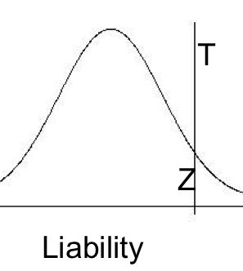
Case control traits
Normally we ascertain cases to be disproportionately represented in our study
Can imagine a continuous risk underlying our observed cases or controls
Once enough risk factors are present above a certain threshold you get the disease
Notes:
The mixed model assumes phenotypes are continuous
clearly not true for binary outcomes, as individuals either cases (1) or controls (0)
We could just ignore this and assume we are measuring a continuous variable “very badly”
but then the extent of measurement error depends on the trait prevalence
e.g., human height fits well a normal distribution
but suppose we could only measure height to the nearest metre
We could still estimate the heritability
but the measurement error would be treated as environmental noise => lower h²

Slide 30
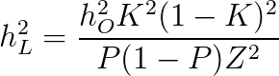
Case control traits
K = prevalence in population
P = proportion cases in sample
Z = height of curve at threshold T
Notes:
Note – what will happen if cases and controls are genotyped separately??

Slide 31
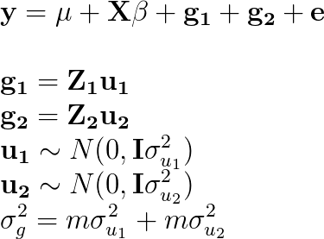
Genomic partitioning
Y = α
+ β₁ X₁ + β₂ X₂ + β₃ X₃ + β₄ X₄ + β₅ X₅ + β₆ X₆ + β₇ X₇ + β₈ X₈
+ β₉ X₉ + β₁₀X₁₀ + β₁₁X₁₁ + β₁₂X₁₂ + β₁₃X₁₃ + β₁₄X₁₄ + β₁₅X₁₅ + β₁₆X₁₆
+ β₁₇X₁₇ + β₁₈X₁₈ + β₁₉X₁₉ + β₂₀X₂₀ + β₂₁X₂₁ + β₂₂X₂₂ + β₂₃X₂₃ + β₂₄X₂₄
+ e
Create multiple GRMs, and estimate the variance attributable to each GRM
Examples:
A partition for each chromosome
Two partitions to compare genic vs non-genic SNPs
Divide SNPs into different MAF categories

Slide 32
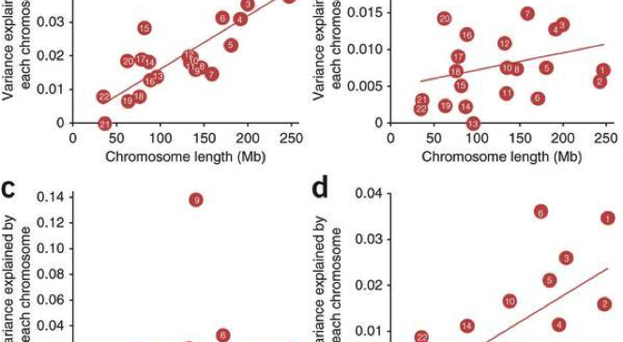
Genome partitioning: polygenic model
Height
BMI
vWF
QTi
Yang et al 2012
Notes:
Shows that larger chromosomes explain more variance: consistent with infinitesimal model.
Also note that sometimes there is a huge effect somewhere, e.g. chr 9 for vWF or chr 6 for Qti

Slide 33
Genetic correlations – bivariate analysis
Y₁ = α₁ + β₁ X₁ + β₂ X₂ + β₃ X₃ + β₄ X₄ + β₅ X₅ + β₆ X₆ + ... + e₁
Y₂ = α₂ + λ₁ X₁ + λ ₂ X₂ + λ ₃ X₃ + λ ₄ X₄ + λ ₅ X₅ + λ ₆ X₆ + ... + e₂
Question: To what extent are the SNPs that influence trait 1 the same that influence trait 2 in terms of concordance of magnitude and direction of effect sizes?
cor(β, λ) = r_{g}, where values can range from -1 to 1.
Use generalised REML implementation which analyses two traits jointly, estimating σ²_{g1} and σ²_{g2} and also r_{g}.
Interpretation:
Proportion of h² that can be explained in trait 1 if perfect knowledge of all SNPs influencing trait 2. And vice versa
Is there pleiotropy between two traits?
Better understand relationship between sub phenotypes

Slide 34
Interpretation
Notes:
SNP h2 estimates for GCSE results and socioeconomic status
Correlation between SES and GCSE
What if there is assortative mating, where individuals with high GCSE results have children with high SES. Those children will have SNPs for both SES and GCSE. May end up looking like a genetic correlation.

Slide 35
Linear mixed models for GWAS
One way to control for population structure is to perform a GWAS where for each SNP you estimate its effect while adjusting for all other SNPs
There now exist many fast implementations for this
FaSTLMM
GenABEL
GEMMA
EMMAX

Slide 36
LD score regression
Imagine every SNP has a random effect
In GWAS, a SNP with high LD would have larger effects because they would be the combined influence of their own effect and those that are correlated with them

Slide 37
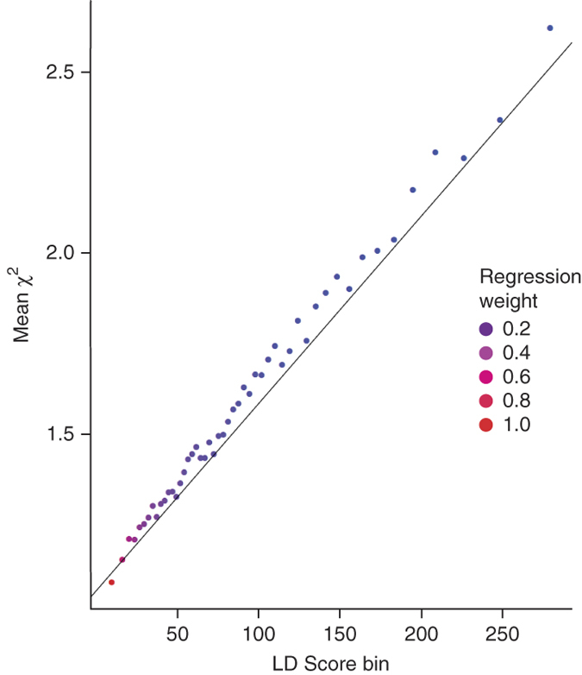
LD score regression
Plot ‘LD score’ (average R²) vs GWAS test statistic
Slope = SNP heritability
Intercept = population stratification

Slide 38
 | GREML | LD Score regression | AVENGEME
Data required | Individual level genetic and phenotypic data | GWAS summary statistics | GWAS summary statistics with replication
Statistical efficiency | High | Low | High
Bivariate analysis | Yes | Yes | Yes
Confounding estimation | No | Yes | No
Estimates of number of causal variants | No | No | Yes
Software available | Yes – GCTA and LDAK | Python scripts and also online platform (LD Hub) | Kind of. R scripts to do calculations but you need to do a few steps first
Reliability of inferences | Biases exist and are somewhat understood | Largely unexplored so far | Largely unexplored so far

Slide 39
Alternatively…
We can also learn about heritability based on how well we can predict a trait based on the results from a GWAS

Slide 40
AVENGEME
Create an allele score based on GWAS results
Calculate the prediction accuracy of the allele score in an independent sample
SNP h2 can be inferred depending on:
Training sample size
Testing sample size
Correlation between PRS and test trait
Threshold used to calculate PRS

Slide 41
References
Useful reviews:
Introduction to Quantitative Genetics. Falconer D.S., Mackay T.F.C. Longman; Harlow, UK: 1996.
Heritability in the genomics era—concepts and misconceptions. Visscher P.M., Hill W.G., Wray N.R. Nat. Rev. Genet. 2008;9:255–266
Relatedness in the post-genomic era: is it still useful? Doug Speed & David J. Balding. Nature Reviews Genetics 16, 33–44 (2015)
The heritability of human disease: estimation, uses and abuses. Tenesa A1, Haley CS. Nat Rev Genet. 2013 Feb;14(2):139-49.
Reconciling the analysis of IBD and IBS in complex trait studies. Powell J.E., Visscher P.M., Goddard M.E. Nat. Rev. Genet. 2010;11:800–805
Finding the missing heritability of complex diseases. Manolio T.A., Collins F.S., Cox N.J., Goldstein D.B., Hindorff L.A., Hunter D.J., McCarthy M.I., Ramos E.M., Cardon L.R., Chakravarti A. Nature. 2009;461:747–753.
Heritability of threshold characters. Dempster E.R., Lerner I.M. Genetics. 1950;35:212–236.
Primary research papers:
Inference of the genetic architecture underlying BMI and height with the use of 20,240 sibling pairs. Hemani G et al. Am J Hum Genet. 2013 Nov 7;93(5):865-75.
Common SNPs explain a large proportion of the heritability for human height. Yang J., Benyamin B., McEvoy B.P., Gordon S., Henders A.K., Nyholt D.R., Madden P.A., Heath A.C., Martin N.G., Montgomery G.W. Nat. Genet. 2010;42:565–569
Genome-partitioning of genetic variation for complex traits using common SNPs. Yang J, Manolio TA, Pasquale LR, et al. Nature genetics. 2011;43(6):519-525. doi:10.1038/ng.823.
Improved heritability estimation from genome-wide SNPs. Speed D, Hemani G, Johnson MR, Balding DJ. Am J Hum Genet. 2012 Dec 7;91(6):1011-21.
Estimating Missing Heritability for Disease from Genome-wide Association Studies. Lee SH, Wray NR, Goddard ME, Visscher PM. American Journal of Human Genetics. 2011;88(3):294-305. doi:10.1016/j.ajhg.2011.02.002.
Estimation of pleiotropy between complex diseases using single-nucleotide polymorphism-derived genomic relationships and restricted maximum likelihood. Lee SH, Yang J, Goddard ME, Visscher PM, Wray NR. Bioinformatics. 2012;28(19):2540-2542. doi:10.1093/bioinformatics/bts474.
LD Score regression distinguishes confounding from polygenicity in genome-wide association studies. Bulik-Sullivan et al. Nature Genetics. 2015
A Fast Method that Uses Polygenic Scores to Estimate the Variance Explained by Genome-wide Marker Panels and the Proportion of Variants Affecting a Trait. Luigi Palla and Frank Dudbridge. AJHG. 2015

